Slide 1

Software Design and Arcitecture(SDA) Lecture 6
Engr.Ramsha Mashood
Senior Lecturer
Department of Software Engineering
Bahria University Karachi Campus

Slide 2




Design patterns

Slide 3

What is design pattern

Slide 4
DEFINITION
Each Pattern describes a problem which occurs over and over again, and then describes the core of the solution to that problem, in such a way that you can use that solution million times over, with out ever doing it the same way twice.
(Christopher Alexander)
(Book: Design Pattern by Erich Gamma | Richard Helm)

Slide 5
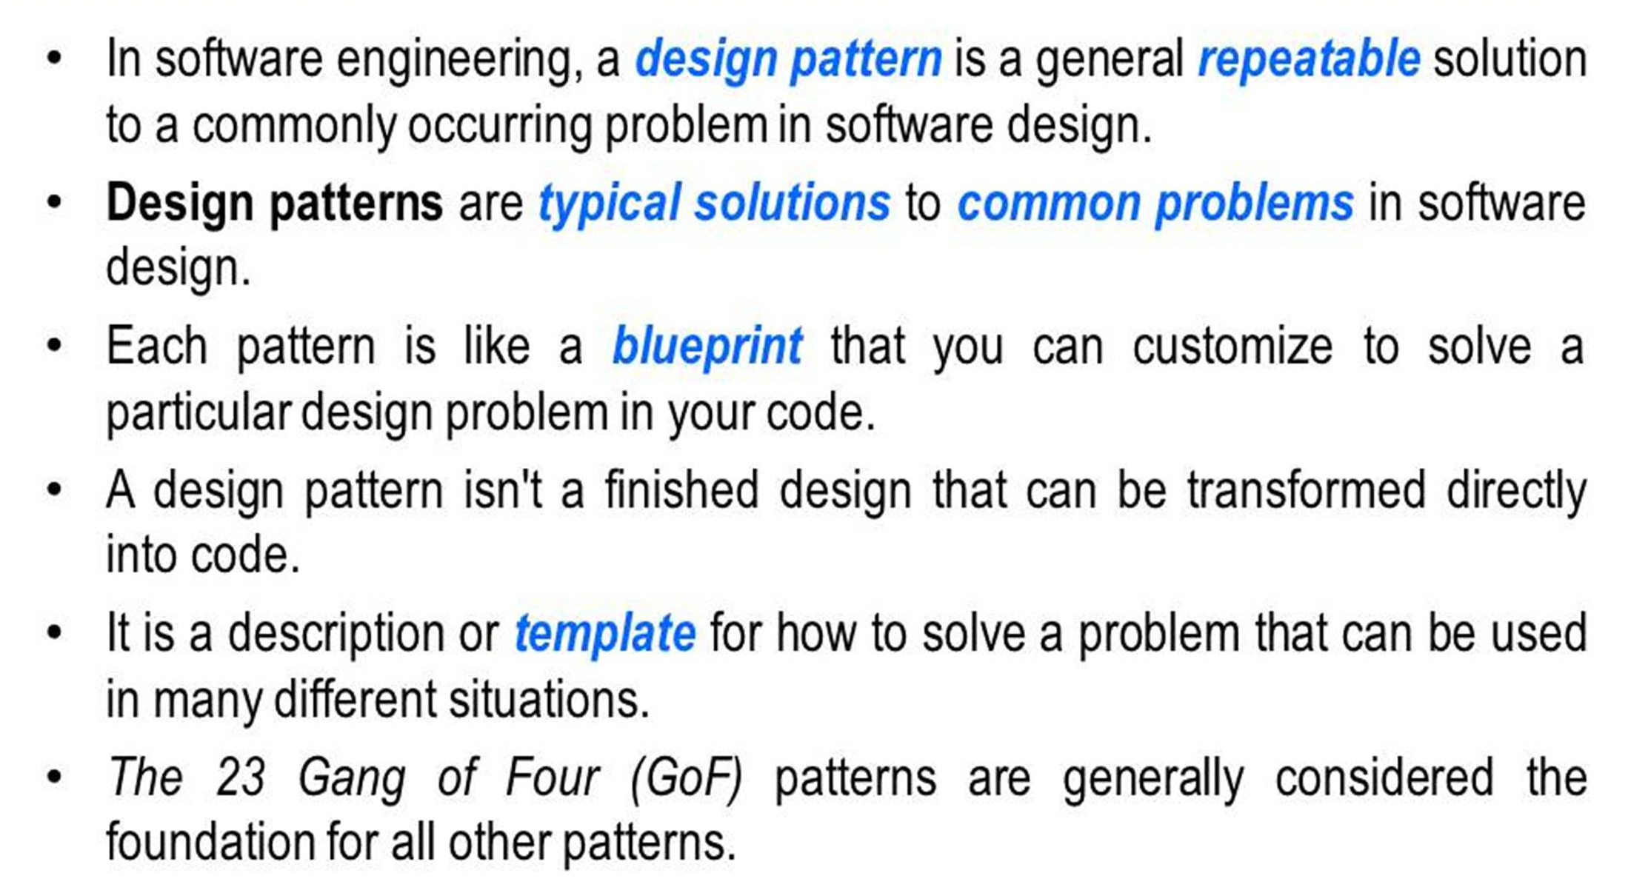
Design pattern

Slide 6
Benefits of Patterns
Shared language of design – Increases communication bandwidth – Decreases misunderstandings
Learn from experience – Becoming a good designer is hard
Understanding good designs is a first step – Tested solutions to common problems

Slide 7
four essential elements:
The pattern name is a handle we can use to describe a design problem, its solutions, and consequences in a word or two. Naming a pattern immediately increases our design vocabulary. It lets us design at a higher level of abstraction.
The problem describes when to apply the pattern. It explains the problem and its context. It might describe specific design problems such as how to represent algorithms as objects .

Slide 8
four essential elements:
The solution describes the elements that make up the design, their relationships, responsibilities, and collaborations. The solution doesn't describe a particular concrete design or implementation, because a pattern is like a template that can be applied in many different situations
The consequences are the results and trade-offs of applying the pattern. Though consequences are often unvoiced when we describe design decisions, they are critical for evaluating design alternatives and for understanding the costs and benefits of applying the pattern

Slide 9
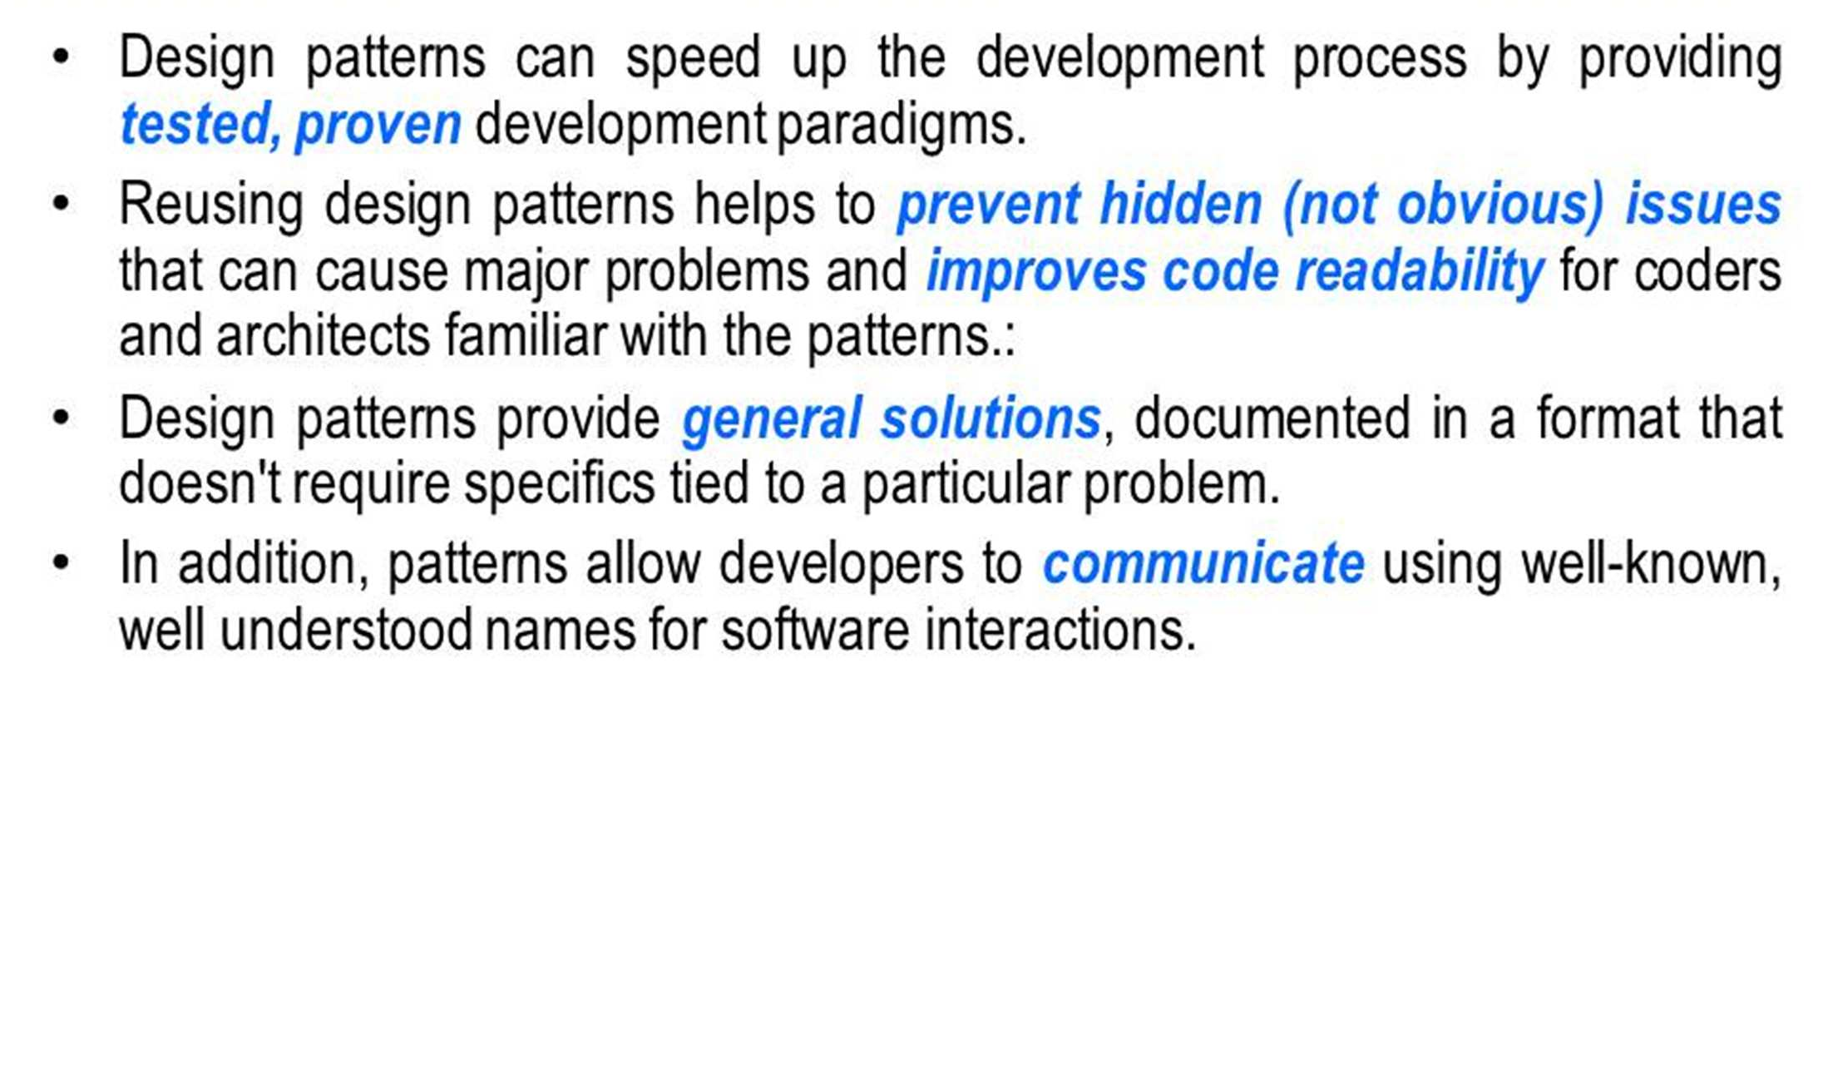
Why use patterns

Slide 10
Describing design patterns
How do we describe design patterns?
Graphical notations, while important and useful, aren't sufficient.
They simply capture the product of the design process as relationships between classes and objects.
To reuse the design, we must also record the decisions, alternatives, and trade-offs that led to it.
Concrete examples are important too, because they help you see the design in action. We describe design patterns using a consistent format.
Each pattern is divided into sections according to the following template.
The template lends a uniform structure to the information, making design patterns easier to learn, compare, and use.

Slide 11
Describing design patterns
Pattern Name and Classification The pattern's name conveys the essence of the pattern succinctly. A good name is vital, because it will become part of your design vocabulary.
Intent A short statement that answers the following questions: What does the design pattern do? What is its rationale and intent? What particular design issue or problem does it address?
Also Known As Other well-known names for the pattern, if any.
Motivation A scenario that illustrates a design problem and how the class and object structuresin the pattern solve the problem. The scenario will help you understand the more abstract description of the pattern that follows.
Applicability What are the situations in which the design pattern can be applied? What are examples of poor designs that the pattern can address? How can you recognize these situations?

Slide 12
Describing design patterns
Structure A graphical representation of the classes in the pattern using a notation based on the Object Modeling Technique (OMT)[RBP+91]. We also use interaction diagrams [JCJO92, Boo94] to illustrate sequences of requests and collaborations between objects.
Participants The classes and/or objects participating in the design pattern and their responsibilities.
Collaborations How the participants collaborate to carry out their responsibilities.
Consequences How does the pattern support its objectives? What are the trade-offs and results of using the pattern? What aspect of system structure does it let you vary independently?

Slide 13
Describing design patterns
Implementation What pitfalls, hints, or techniques should you be aware of when implementing the pattern? Are there language-specific issues?
Sample Code Code fragments that illustrate how you might implement the pattern in C++ or Smalltalk.
Known Uses Examples of the pattern found in real systems. We include at least two examples from different domains.
Related Patterns What design patterns are closely related to this one? What are the important differences? With which other patterns should this one be used?

Slide 14
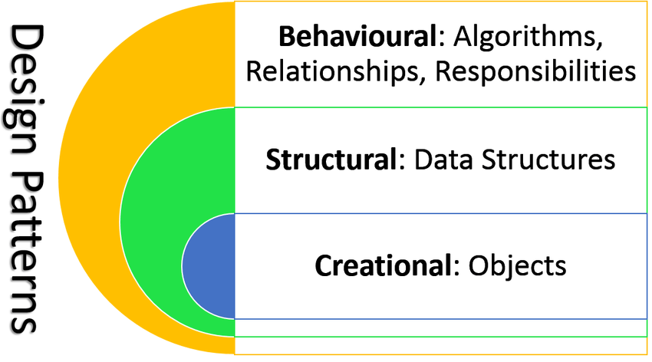

Slide 15
Classification of design patterns
Creational patterns provide object creation mechanisms that increase flexibility and reuse of existing code.
Structural patterns explain how to assemble objects and classes into larger structures, while keeping these structures flexible and efficient.
Behavioral patterns take care of effective communication and the assignment of responsibilities between objects.

Slide 16
Classification
Patterns can be classified
With respect to purpose.
With respect to scope.
With respect to purpose, patterns are classified to
Creational, Structural and Behavioral. For example,
The Observer pattern is a behavioral pattern (because it help us model the behavior and interactions of objects)
The Builder pattern is a creational pattern (because it details how an object can be created in a particular way) and so on.

Slide 17
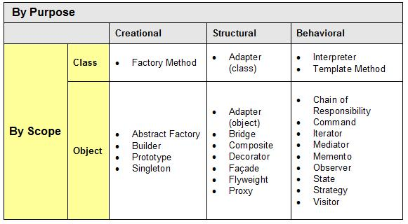
classification

Slide 18
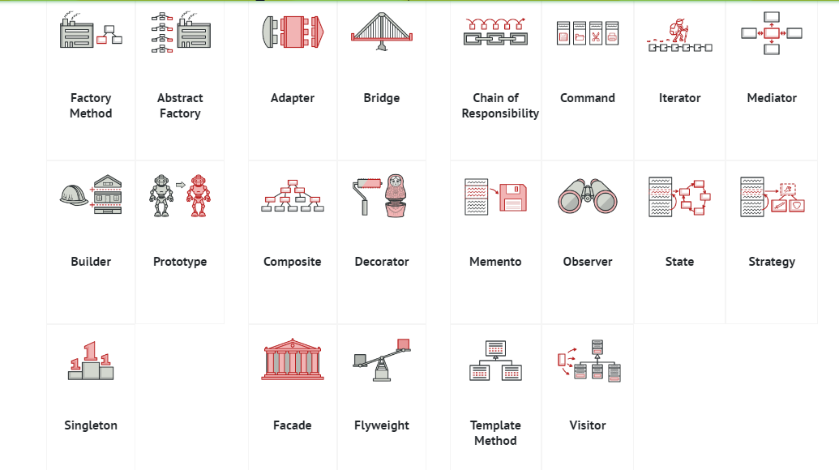
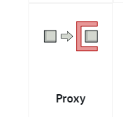
classification

Slide 19

Creational pattern

Slide 20
Singleton
Singleton is a creational design pattern that lets you ensure that a class has only one instance, while providing a global access point to this instance.

Slide 21
Solve two problem
Ensure that a class has just a single instance. Why would anyone want to control how many instances a class has? The most common reason for this is to control access to some shared resource—for example, a database or a file.
Provide a global access point to that instance. Remember those global variables that you (all right, me) used to store some essential objects? While they’re very handy, they’re also very unsafe since any code can potentially overwrite the contents of those variables and crash the app.

Slide 22
Real world analogy
The government is an excellent example of the Singleton pattern. A country can have only one official government. Regardless of the personal identities of the individuals who form governments, the title, “The Government of X”, is a global point of access that identifies the group of people in charge.
Take a scenario, say for a Company application, there is only one CEO. If you want to create or access CEO object, you should return the same CEO object every time.
One more, after logging into an application, current user must return same object every time

Slide 23
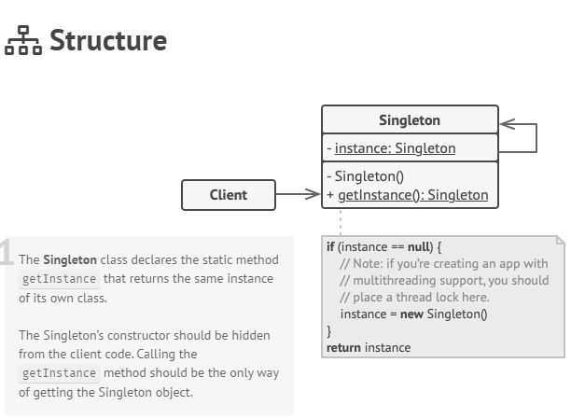

Slide 24
FACTORY METHOD
In Factory pattern, we create object without exposing the creation logic. In this pattern, an interface is used for creating an object, but let subclass decide which class to instantiate. The creation of object is done when it is required. The Factory method allows a class later instantiation to subclasses

Slide 25
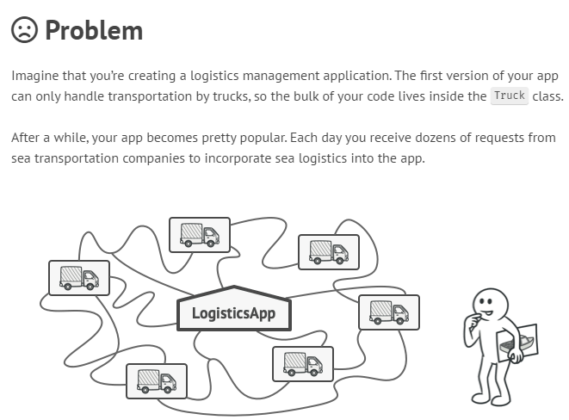

Slide 26
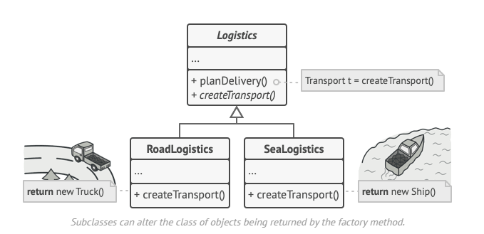

Slide 27
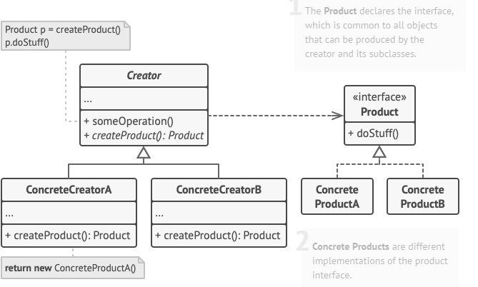
STRUCTURE

Slide 28

Abstract Factory Pattern
Provides an interface for creating families of related or dependent objects without specifying their concrete classes
Or
Abstract factory pattern is a super factory which creates other factories. This factory is also called factory of factories.
Also Known As: Kit

Slide 29
In Depth
Consider an interface toolkit that supports multiple look-and-feel standards, such as Motif and Presentation Manager. Different look-and-feels define different appearances and behaviors for user interface “widgets” like scroll bars, windows and buttons. To be portable across look-and-feel standards, an application should not hardcode its widgets for a particular look and feel. This can be solved by defining an abstract Widget Factory class that declares an interface for creating each basic kind of widget. There’s also an abstract class for each kind of widget, and concrete subclasses implement widgets for specific look-and-feel standards. Widget Factory’s interface has no operation that returns a new widget object for each abstract widget class. Clients call these operations to obtain widget instances, but clients aren’t aware of the concrete classes they’re using. Thus, clients stay independent of the prevailing look and feel

Slide 30
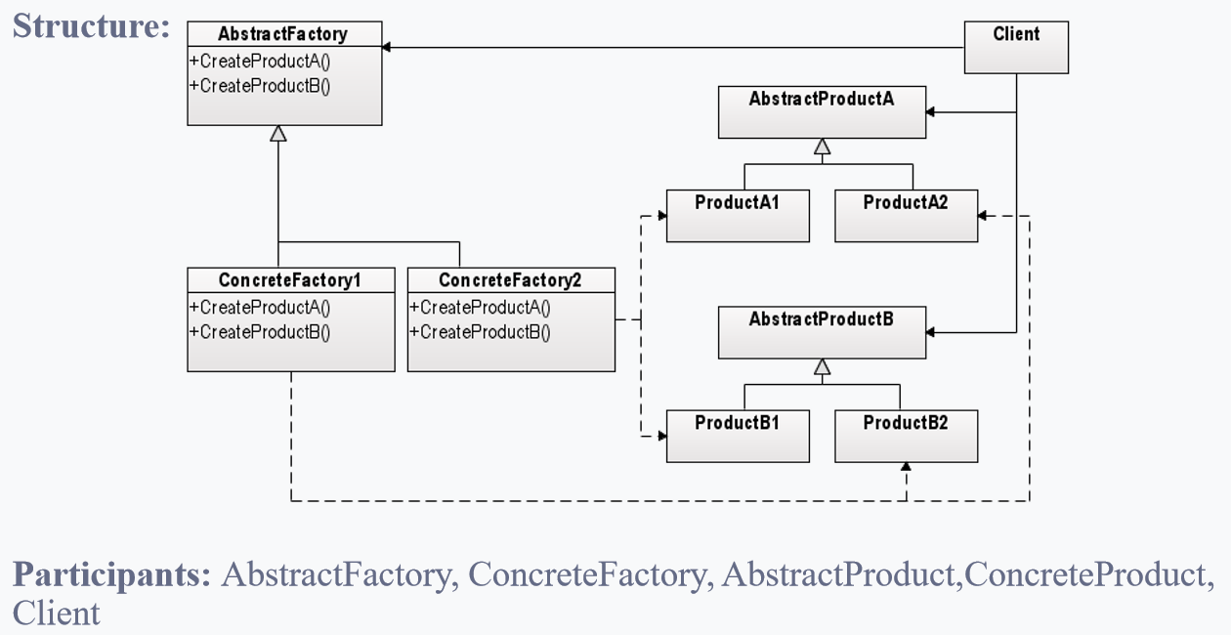

Slide 31
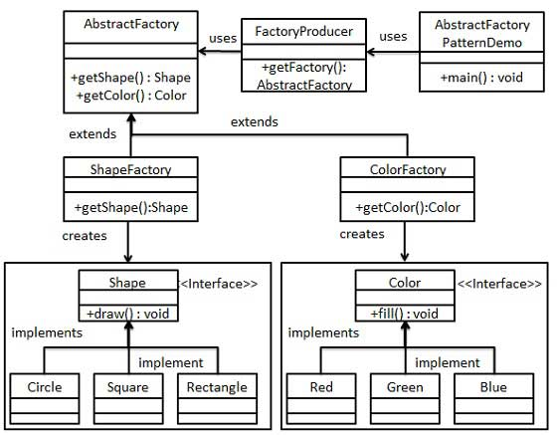

Slide 32
Collaborations:
Normally a single instance of a Concrete Factory class is created at run-time
Consequences:
The Abstract Factory pattern has the following benefits and liabilities:
Isolating concrete classes
Exchanging product families easy
Promoting consistency among products
Supporting of new kinds of products is difficult
Related Patterns:
Abstract Factory classes are often implemented with factory methods, but they can also be implemented using Prototype. A Concrete Factory is often a Singleton

Slide 33
Factory Pattern: 1. Create object through inheritance
2. Produce only one product
3. Implements code in the abstract creator that make use of the concrete type that sub class produces.
Abstract Factory Pattern: 1. Create object through composition
2. Produce families of products
3. Concrete factories implements factory method to create product

Slide 34
Builder
Builder is a creational design pattern that lets you construct complex objects step by step. The pattern allows you to produce different types and representations of an object using the same construction code.

Slide 35
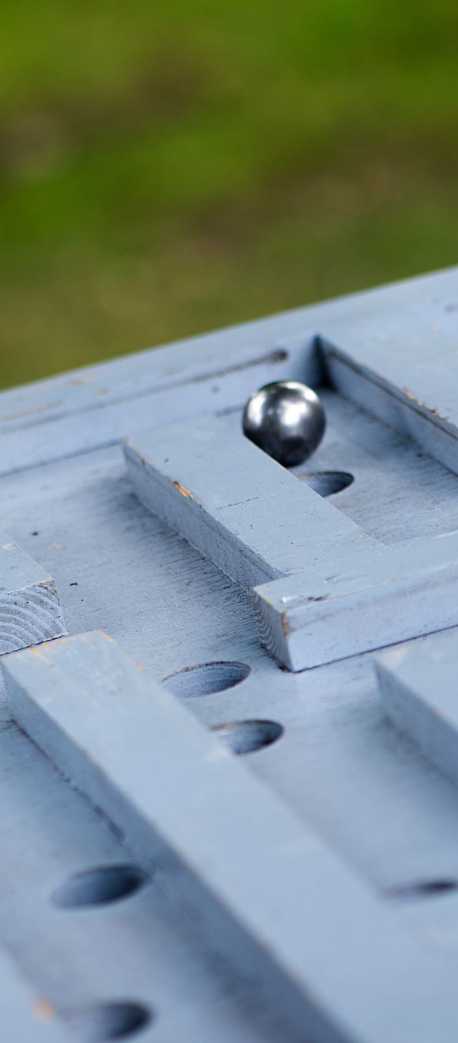
Builder Pattern
Builder Pattern Builds a complex object using simple objects and using step by step approach.
Or
The process of constructing object should be generic so that the same process can be used to create different representations of the same complex object.

Slide 36
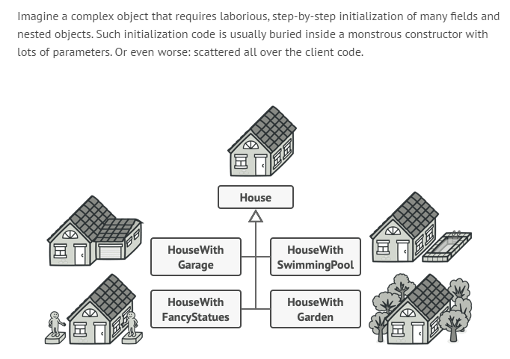

Slide 37
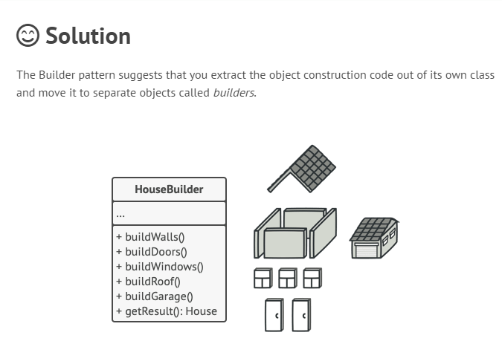

Slide 38
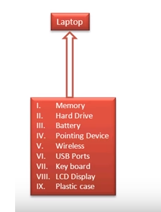
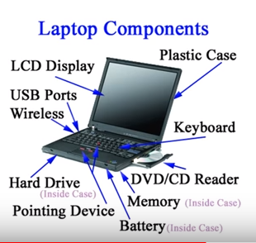
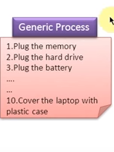
Example

Slide 39

Motivation
There are two specific problems that we need to solve:
Too many constructor arguments.
Incorrect object state.
This is where the Builder pattern comes into play.

Slide 40
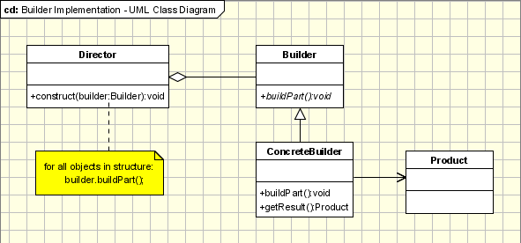
UML The Builder design pattern uses the Factory Builder pattern to decide which concrete class to initiate in order to build the desired type of object, as we will see below in the UML diagram:

Slide 41
In depth
The participants classes in this pattern are:
The Builder class specifies an abstract interface for creating parts of a Product object.
The Concrete Builder constructs and puts together parts of the product by implementing the Builder interface. It defines and keeps track of the representation it creates and provides an interface for saving the product.
The Director class constructs the complex object using the Builder interface.
The Product represents the complex object that is being built.

Slide 42
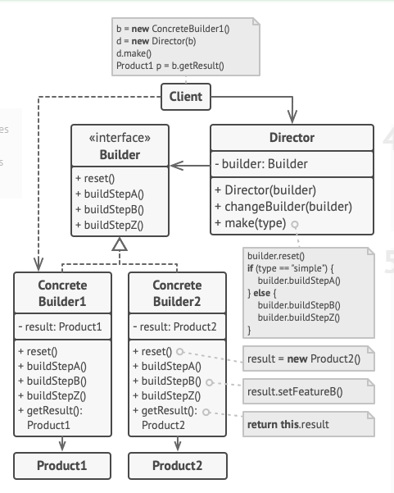

Slide 43

Prototype Pattern
Specifying the kind of objects to create using a prototypical instance. creating new objects by copying this prototype

Slide 44
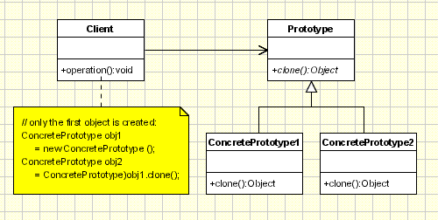
UML The pattern uses abstract classes, as we will see below and only three types of classes making its implementation rather easy.

Slide 45

In depth
The classes participating to the Prototype Pattern are:
Client - creates a new object by asking a prototype to clone itself.
Prototype - declares an interface for cloning itself.
ConcretePrototype - implements the operation for cloning itself.

Slide 46
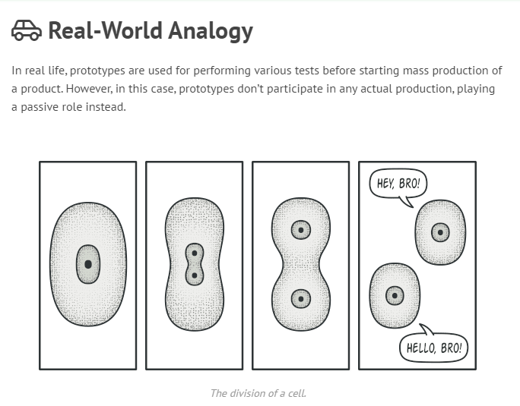

Slide 47
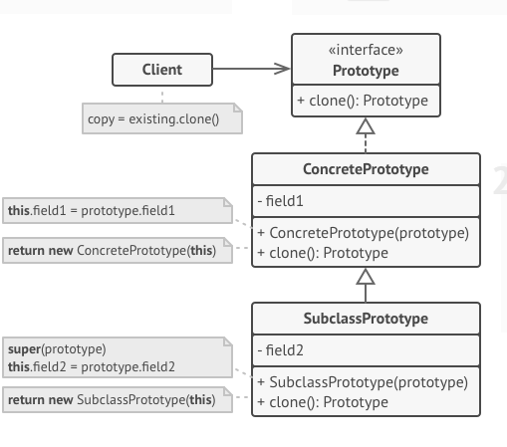

Slide 48
Useful links
https://refactoring.guru/design-patterns
https://sourcemaking.com/design_patterns

Slide 49
Continue….
Any thing to ask ??

